Slide 1




Predicting Credit Risk Defaulters

Slide 2
Overview
Introduction
Problem Statment
Data Description
Data Preprocessing
Objectives
Model
Evaluation
Results
01
02
04
05
06
16
17
18

Slide 3


Introduction
1
Minimizing risks is crucial for banks, and predicting potential loan defaults helps in managing credit risk and preventing losses. Customer segmentation enables targeted marketing and better customer service. This case study uses loan, transaction, and account data to uncover valuable patterns, with the following objectives:
Predict the likelihood of loan defaults.
Segment customers for personalized marketing.
Provide actionable insights for better customer management and risk mitigation.

Slide 4


2
Problem Statement:
A mid-sized bank aims to identify customers who are likely to default on their loans within the next 6 months. Additionally, the bank wants to segment its customers for targeted marketing. The bank has provided customer data, including loan information, transaction history, and account details.

Slide 5


3
Situation
The dataset provides detailed customer information, aiming to predict loan defaults and segment customers for targeted strategies.
Challenges
Handling missing data, ensuring accurate predictions, and addressing data imbalances for effective segmentation.
Solution
Using imputation techniques, machine learning models, and customer segmentation to predict defaults and offer personalized financial strategies.

Slide 6

The dataset includes customer demographics (age, income, occupation, marital status), loan details (type, amount, term, interest rate, default status), transaction history, and account information (balance, tenure, savings). These attributes are key for targeted analysis to address the problem statement.
4
DATA
DESCRIPTION
Customer_ID | Age | Gender | Income | Credit_Score | Loan_Amount | Loan_Term | Number_of_Loans | Transaction_Count | Account_Balance | Marital_Status | Credit_Default_Status | Job
1 | 69 | Male | 37114 | 678 | 4905.22 | 12 | 1 | 18 | 3836.25 | married | 0 | Other
2 | 98 | Male | -49215 | 778 | 6374.88 | 12 | 3 | 4 | 5300.84 | unmarried | 0 | Other
3 | 60 | Female | 34352 | 696 | 6622.15 | 36 | 5 | 8 | 5668.57 | married | 0 | Other
4 | 51 | Male | 121193 | 655 | 25610.96 | 24 | 2 | 10 | 9202.42 | divorced | 0 | Other
5 | 46 | Female | 115249 | 702 | 22509.28 | 72 | 5 | 13 | 8138.34 | married | 0 | Other
6 | 97 | Female | 62479 | 533 | 11262.37 | 72 | 4 | 0 | 1559.15 | married | 1 | Other
7 | 24 | Male | 34224 | 763 | 8858.11 | 12 | 5 | 21 | 6584.89 | unmarried | 0 | Other
8 | 54 | Female | 98236 | 480 | 34270.35 | 36 | 2 | 3 | 2260.55 | married | 1 | Other
9 | 46 | Female | 60480 | 718 | 22461.11 | 12 | 5 | 9 | 6025.93 | unmarried | 0 | IT Professional
10 | 30 | Male | 104003 | 677 | 12096.57 | 60 | 5 | 6 | 5864.46 | divorced | 0 | Other
Table 1: Sample Dataset

Slide 7

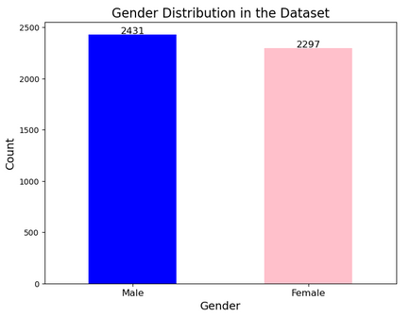
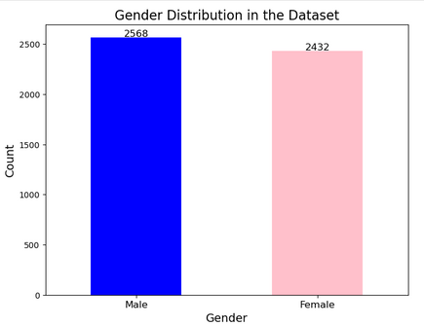
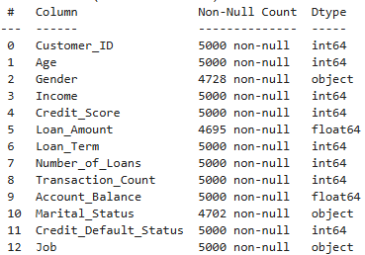
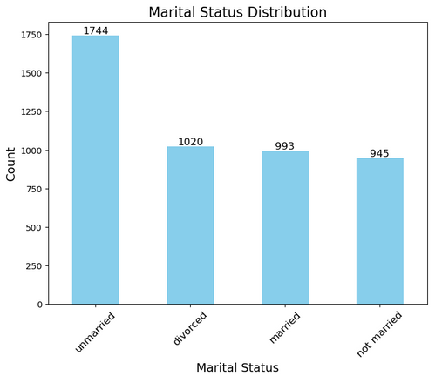
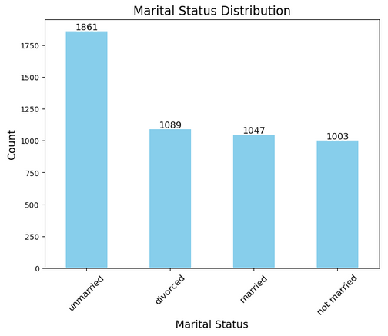
Data Preprocessing
5
Gender Distribution
Missing values are imputed using probabilities from existing data, ensuring completeness and reliability for analysis.
Marital Status Distribution

Slide 8
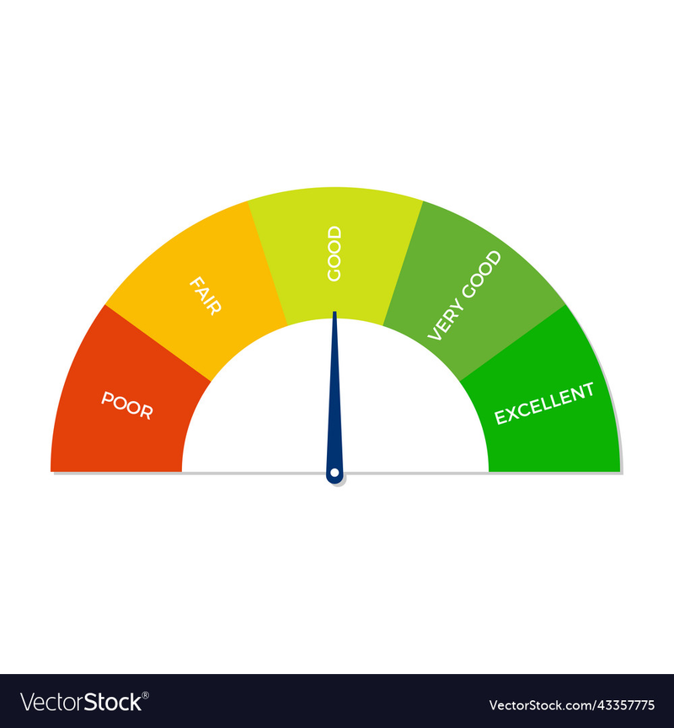
6
Objectives
Customer Demographics Analysis
Transcations and Balance Anaylsis
Behavioural Insights
Data Understanding20

Slide 9

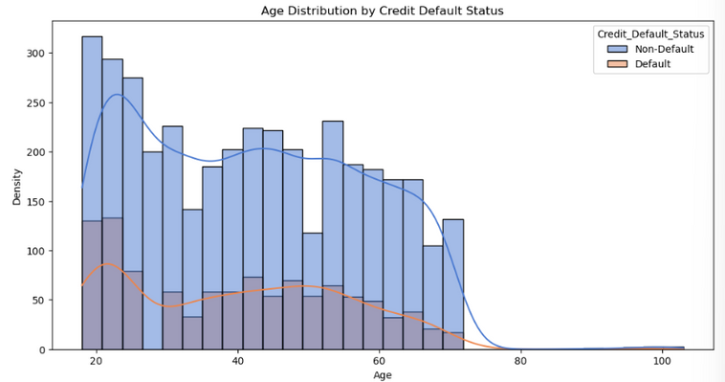
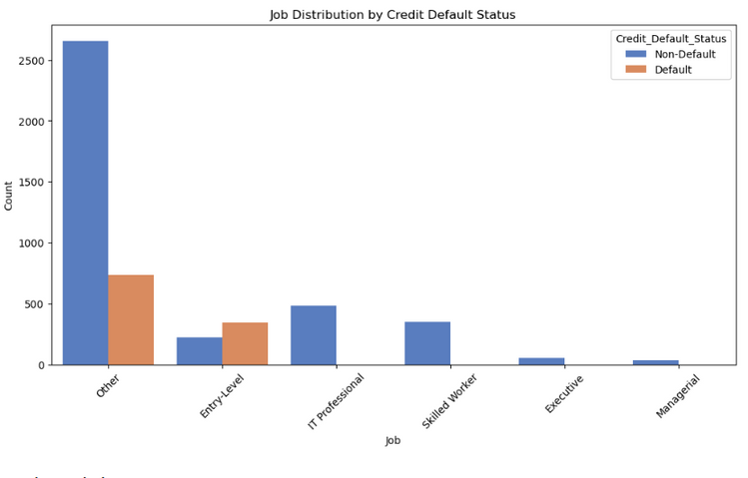
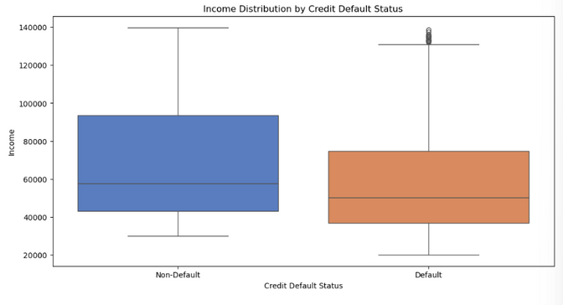
7
Customer Demographics Analysis
AGE DISTRIBUTION ANALYSIS
OCCUPATION ANALYSIS
INCOME ANALYSIS

Slide 10
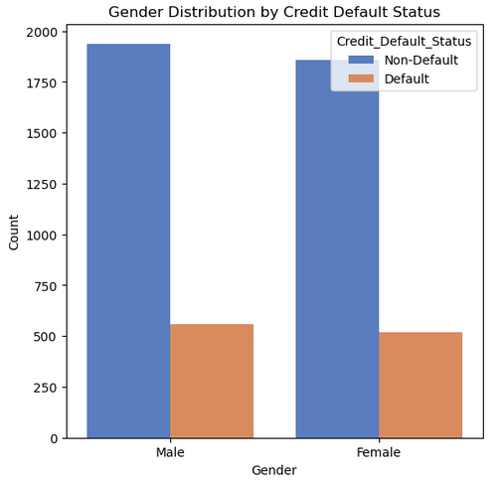
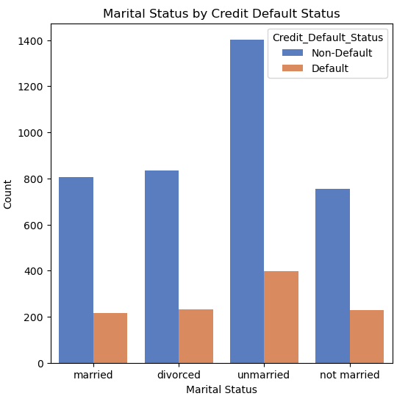
8
Customer Demographics Analysis
GENDER ANALYSI
MARITAL STATUS
ANALYSIS
AVERAGE LOAN AMOUNT AND LOAN TERM GROUPED BY CREDIT DEFAULT STATUS
Credit Default Status | Loan Amount | Loan Term
Default | 14,408.59 | 42.13
Non-Default | 17,032.05 | 42.05

Slide 11
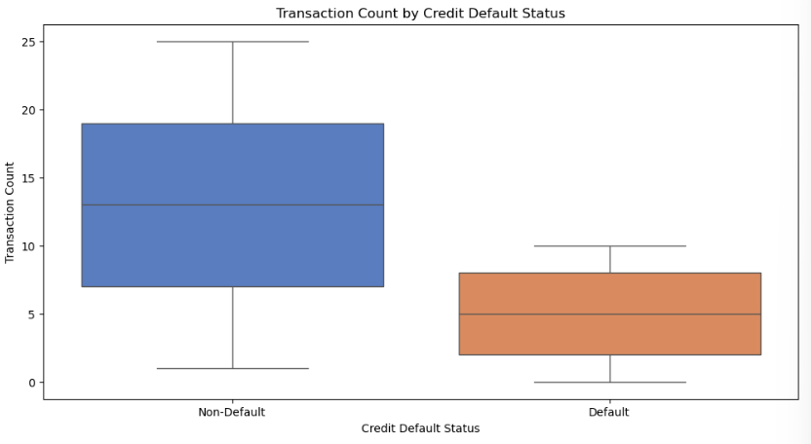
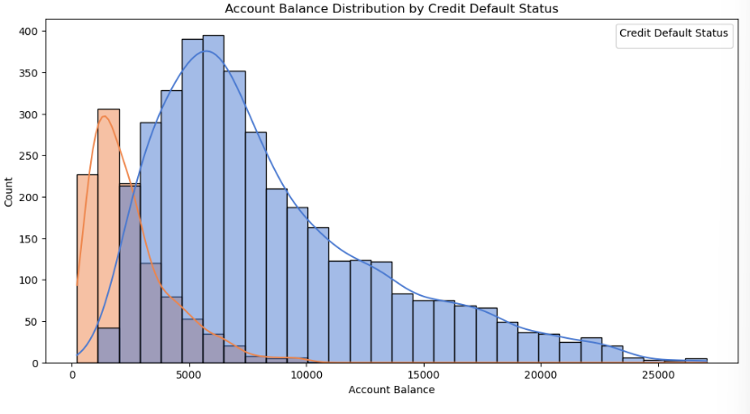

9
Transcations and Balance Anaylsis
Transaction count analysis
Account Balance Analysis

Slide 12
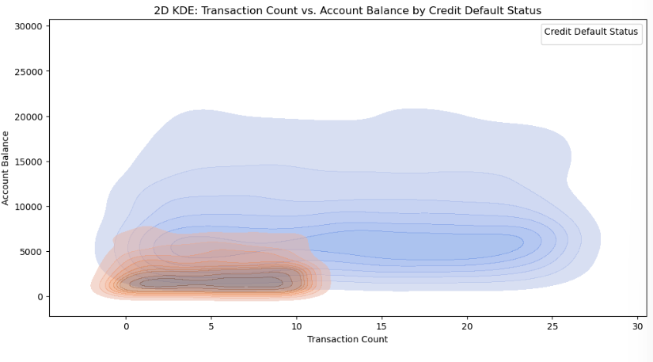
10
Transcations and Balance Anaylsis
Statistics for Transaction Count and Account Balance by Credit Default Status
Joint Analysis of Transaction Count and Account Balance

Slide 13

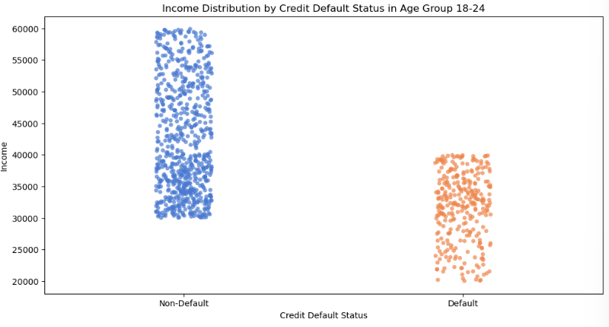
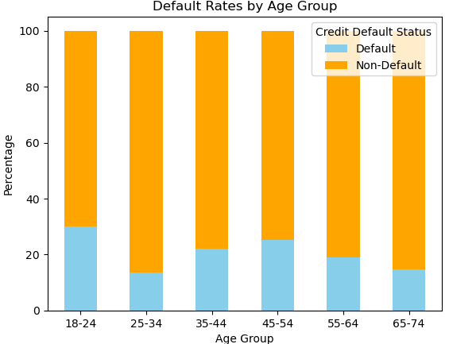

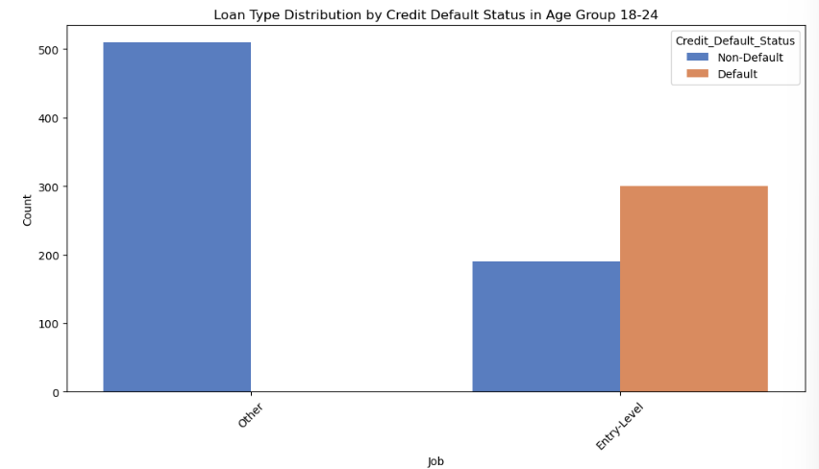
INCOME VS. DEFAULT STATUS IN HIGH-DEFAULT AGE GROUP
Behavioural Insights
11
AGE GROUP DEFAULT RATES
LOAN TYPE DISTRIBUTION IN HIGH-DEFAULT AGE GROUP

Slide 14
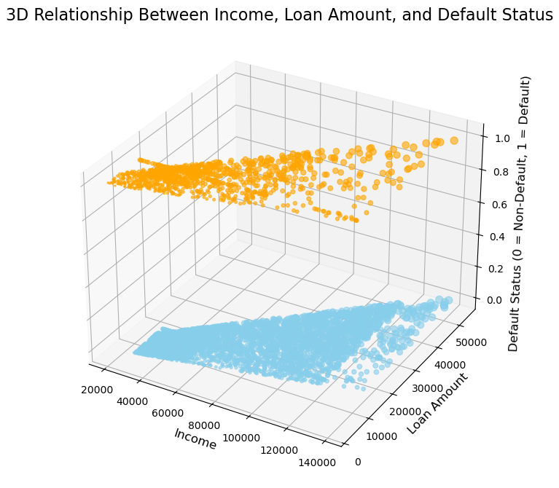
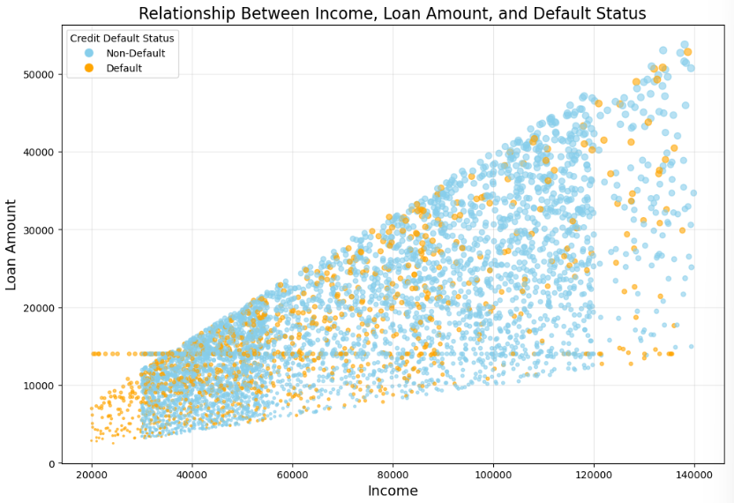
12
Behavioural Insights

Slide 15
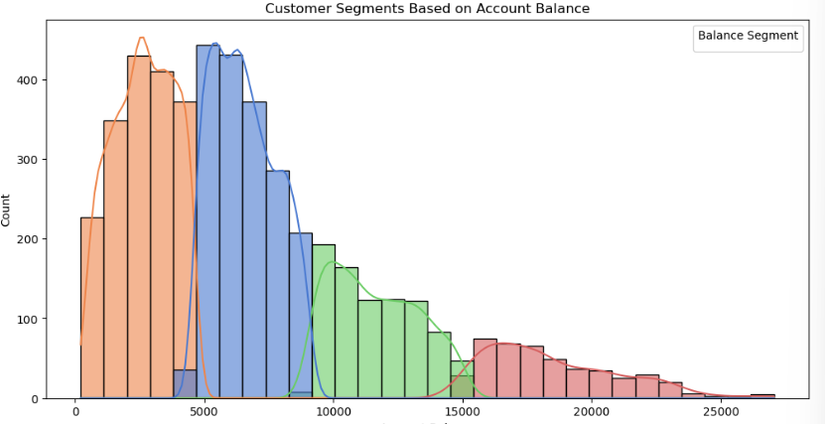
Data Understanding
13
K-Means clustering to segment customers based on account balance and visualizes the distribution of these segments, followed by a summary of key statistics for each segment.
Balance Segment | Avg Balance | Min Balance | Max Balance | Count
0 | 6,568.27 | 4,617.62 | 9,104.41 | 1,774
1 | 2,648.07 | 219.89 | 4,616.52 | 1,786
2 | 11,618.46 | 9,112.76 | 15,070.46 | 864
3 | 18,512.03 | 15,084.25 | 27,058.50 | 450

Slide 16
How the Bank Can Use These Segments for Marketing
14
Describing the Segments
Low Balance Group: Financially constrained customers; offer financial literacy and small loans.
Moderate Balance Group: Financially stable but cautious; promote savings and investment options.
High Balance Group: Affluent individuals; target with premium services and investment opportunities.
Very High Balance Group: High-net-worth individuals or businesses; offer exclusive wealth management and personalized solutions.
Targeted Offers:
Low-balance customers can be offered products to build financial resilience.
High-balance customers can be marketed premium services or tailored investment plans.
Risk Management:
Segmenting customers can help identify those at higher risk of defaults (e.g., low-balance group).
Customer Retention:
Create loyalty programs for mid-tier customers to encourage sustained engagement.

Slide 17
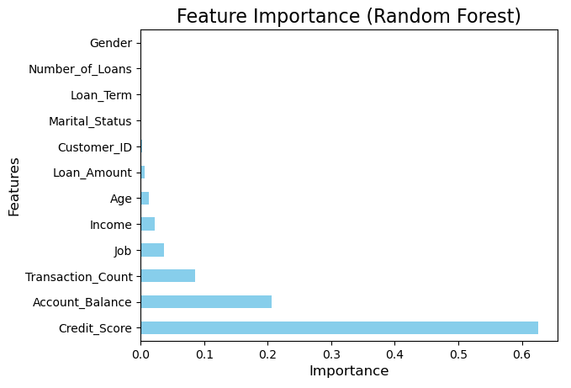

15
Feature Importance
Feature | Importance
Credit_Score | 0.625245
Account_Balance | 0.206584
Transaction_Count | 0.085193
Job | 0.036466
Income | 0.022457
Age | 0.013179
Loan_Amount | 0.005846
Customer_ID | 0.001737
Marital_Status | 0.001407
Loan_Term | 0.000965
Number_of_Loans | 0.000618
Gender | 0.000302
Random Forest model to predict credit default status, evaluates feature importances, and visualizes them to identify the most influential factors.

Slide 18

16
Model Architecture
Layer Type | Output Shape | Number of Parameters
Input Layer | (None, 64) | 0
Dense (64 units) | (None, 64) | 4,160
Dropout (0.5) | (None, 64) | 0
Dense (32 units) | (None, 32) | 2,080
Dropout (0.5) | (None, 32) | 0
Dense (1 unit) | (None, 1) | 33
Total Parameters |  | 6,273

Slide 19
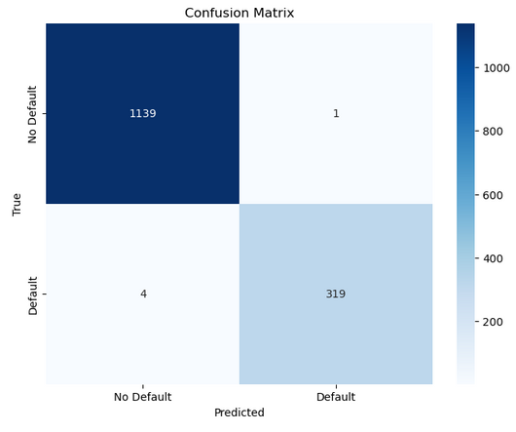
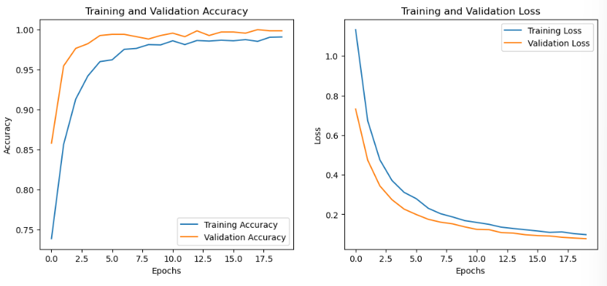
Model Evaluation Metrices
17
Class | Precision | Recall | F1-Score | Support
0 | 1.00 | 1.00 | 1.00 | 1,140
1 | 1.00 | 0.99 | 0.99 | 323
Accuracy |  |  | 1.00 | 1,463
Macro Avg | 1.00 | 0.99 | 1.00 | 1,463
Weighted Avg | 1.00 | 1.00 | 1.00 | 1,463

Slide 20
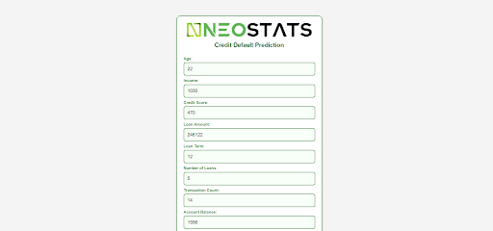
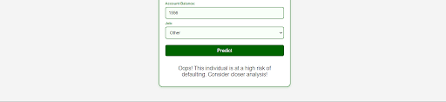
Results
18

Slide 21



19
THANK TOU
For watching this presentation
Haripriya MC
7411718148
mcharipriya03@gmail.com

